Slide 1
Lecture:1 An Overview of OOP and C++
Prepared By: Sumaiya Binte Shahid
Lecturer
Department of CSE, BUBT

Slide 2
What is Object-Oriented Programming?
Object-Oriented Programming (OOP) is a paradigm based on the concept of "objects," which are instances of classes.
OOP aims to model real-world entities with attributes (data) and behaviors (methods).
Enhances modularity and reusability.

Slide 3
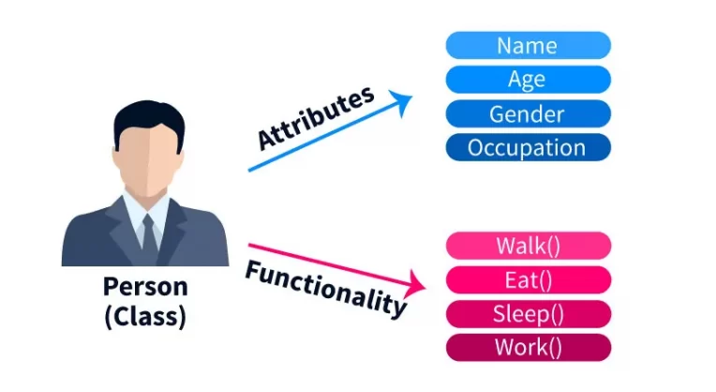
Visualization
Example:
A class called "Person" may include fields like "name," "age," and "gender," as well as producers like "speak," "eat," and "sleep." Multiple person objects can be created from this class, each with its own unique values for the fields.
A “Car” class with attributes like color, model, and behaviors like drive, brake.

Slide 4
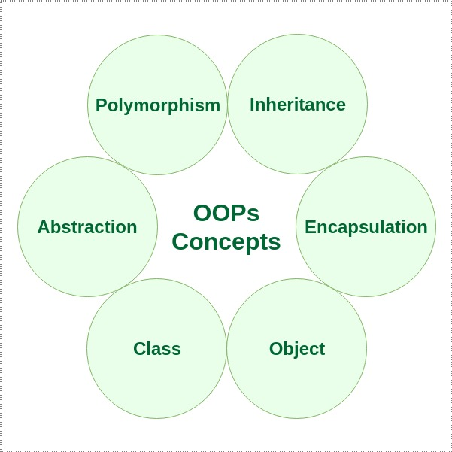
Features of OOP

Slide 5
Key Features of OOP
.
Encapsulation: Bundling of data and methods that operate on the data.
Abstraction: Hiding complex implementation details and showing only the necessary features.
Inheritance: Mechanism by which one class can inherit attributes and methods from another.
Polymorphism: Ability to present the same interface for different underlying data types.

Slide 6
Features of C++
.
Enhanced version of C.
Higher level language than C
Add supports of object-oriented programming.
Every C language features are available in C++.
Rich library support.
Fast speed to compile.
Compiler Based

Slide 7
Evolution of C++: Major Versions
.
C++98/C++03: Standardized versions, introducing features like templates and STL.
C++11: Major updates including auto keyword, lambda expressions, and more.
C++14: Minor improvements and bug fixes over C++11.
C++17:Enhanced performance, added features like structured bindings, and optional.
C++20: Major release with concepts, ranges, co-routines, and more.

Slide 8
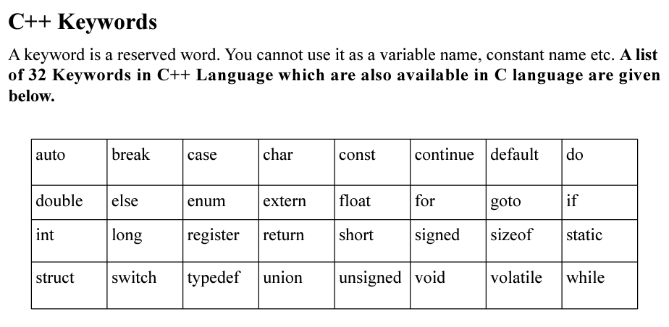
Keywords in C++
.

Slide 9
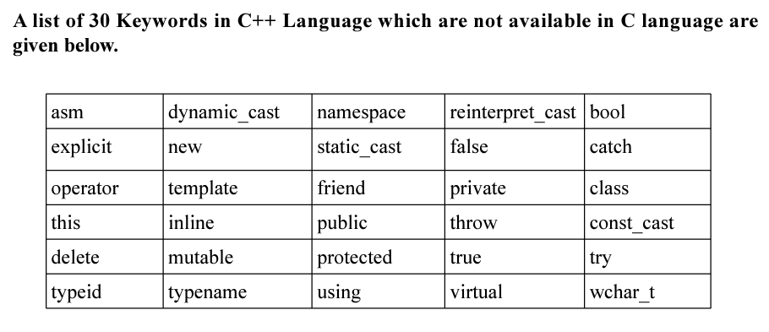
Keywords in C++ ( Continue..)
.

Slide 10
Application of C++
.
Problem solving(ACM contest).
Operating System(OS) : Microsoft Windows, Mac, Linux.
Browser: Faster execution.
Graphics: Reducing the latency.
Banking Application: Example: Infosys Finacle
Cloud and distributed system.
Databases: Example: Postgres and MySQL.

Slide 11
Difference Between C & C++
Features | C | C++
Paradigm | Primarily procedural programming language | Multi-paradigm language supporting procedural, object-oriented, and generic programming
Classes and Objects | Does not support | Supports
Function Overloading | Does not support | Supports function overloading, allowing multiple functions with the same name but different parameters.
Standard Library | Relies on the C Standard Library (<stdio.h>, <stdlib.h>, etc.) | Extends the C Standard Library with the Standard Template Library (STL), providing containers, algorithms, iterators, and other utilities
Keywords | Small set of keywords | Broader set of keywords

Slide 12
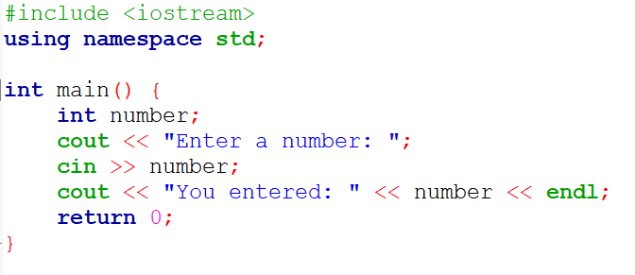
Basic Console Input / Output in C++

Slide 13
Headers in C++
#include <iostream> :
A preprocessor directive.
Lines that begin with # are processed by the preprocessor before the program is compiled.
include in the program the contents of the input/output stream header <iostream>.
Examples:
<math.h>
<string.h>
<cmath>
<cstring>
We also can use C header files!!

Slide 14
Other Structural Contents in C++
using namespace std; - std is the namespace where C++ standard class libraries are defined
cin>> used for take input
cout<< used for display output.
The << operator is referred to as the stream insertion operator.
Return 0: Use to EXIT function

Slide 15
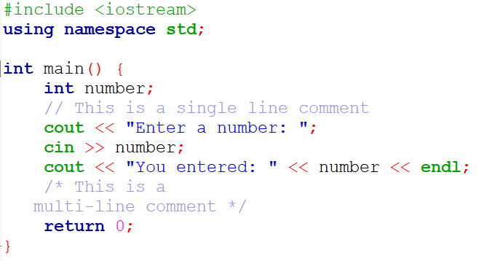
Comments in C++
Single-line Comments: Using // to comment out a single line.
Multi-line Comments: Using /* ... */ to comment out multiple lines.
Importance of comments for code readability and maintenance.

Slide 16
Introduction to Class in C++
.
Blueprint for objects.
Collection of related data and function under a single name.
Way of organizing information about a type of data so a programmer can reuse elements when making multiple instances of that data type.
Has mutual methods.

Slide 17
Introduction to Class in C++ (Continue..)
.
A class in OOP can contain methods, fields, constructors, nested class, interface etc.
A C++ program can have any number of classes.
Do not consume any memory until the objects are created.
When related data and functions are kept under a class, it helps to visualize the complex problem efficiently and effectively.

Slide 18
Introduction to Object in C++
.
An Object is an instance of a Class.
To use the data and access functions defined in the class, you need to create objects.
Syntax for declaring object:
ClassName ObjectName;

Slide 19
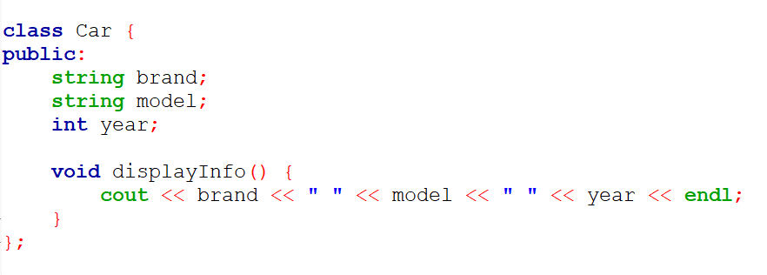
How to Declare Class in C++?
Functions and variables declared inside a class declaration are said to be members of this class.

Slide 20
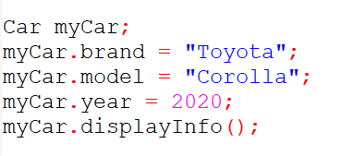
Creating and Using Objects of a Class

Slide 21

Thank You.

